Slide 1

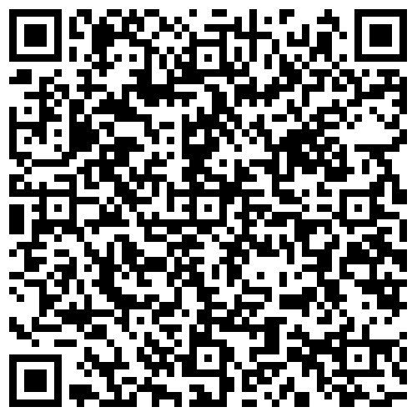
Scan to sign in

Slide 2
2024
SFHS volleyball informationAl meeting

Slide 3
jr war eagles
Students zoned for sfhs
booster fee: $300
practice
monday-Thursday 6-8 pm @ SFHS
(A team will practice some Fridays)
Games
weekdays & weekends
(parents are responsible for travel)
camp
june 3-6 register @parks.Forsythco.com
Contact
coach Deanna Cox deannaccox@gmail.com

Slide 4
HS Program Overview
Freshman Team: Athletes in 9th Grade
JV Team: Athletes in 9-11th Grade
Varsity Team: athletes 9-12th Grade
booster fee information in progress
Contact: Coach Christina f43887@forsythk12.org

Slide 5
Tryouts for HS
(9th, JV, Varisty)
Location: Arena, SFHS
Friday May 10, 2024
Varsity: 4 - 5:30 PM
9th & JV: 6 - 7:30 PM
Saturday May 11, 2024
9th & JV: 9 - 10:30 AM
Varsity: 11 Am - 12:30 PM

Slide 6
Tryouts for Jr Eagles
(feeder Team)
Location:
Arena @ SFHS
Saturday, May 11, 2024
When:
2:00 - 4:00 PM

Slide 7
Dragonfly & Physicals
Diane King, MS, ATC, RD, CSSD
Athletic Trainer, South Forsyth HS
Children’s Healthcare of Atlanta Sports Medicine
performnutrition@bellsouth.net
(NO SCHOOL EMAIL)
404-354-0008

Slide 8
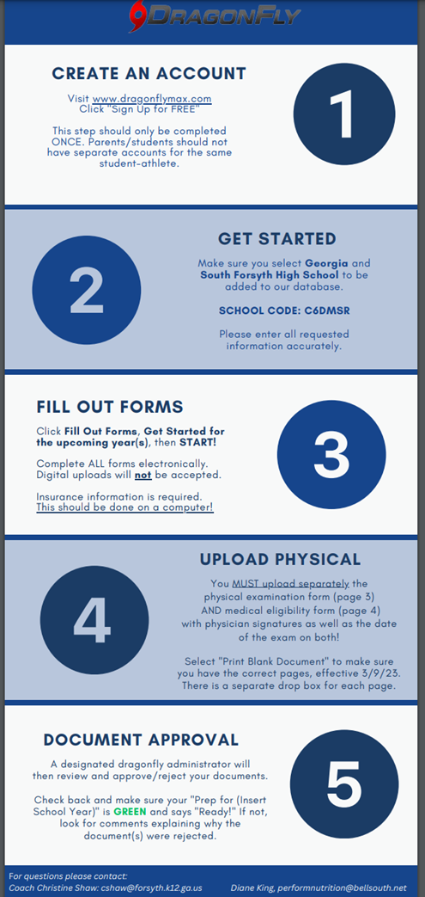
How to set up a DragonFly Account
  Copies are available here
  You only must do this once for the time your athlete is at South. Do not sign up annually or for multiple sports
  Only the athlete needs an account. Make sure everyone knows how to log in.
  Take note there are electronic forms that must be signed by athlete and parent. Other forms must be uploaded.

Slide 9
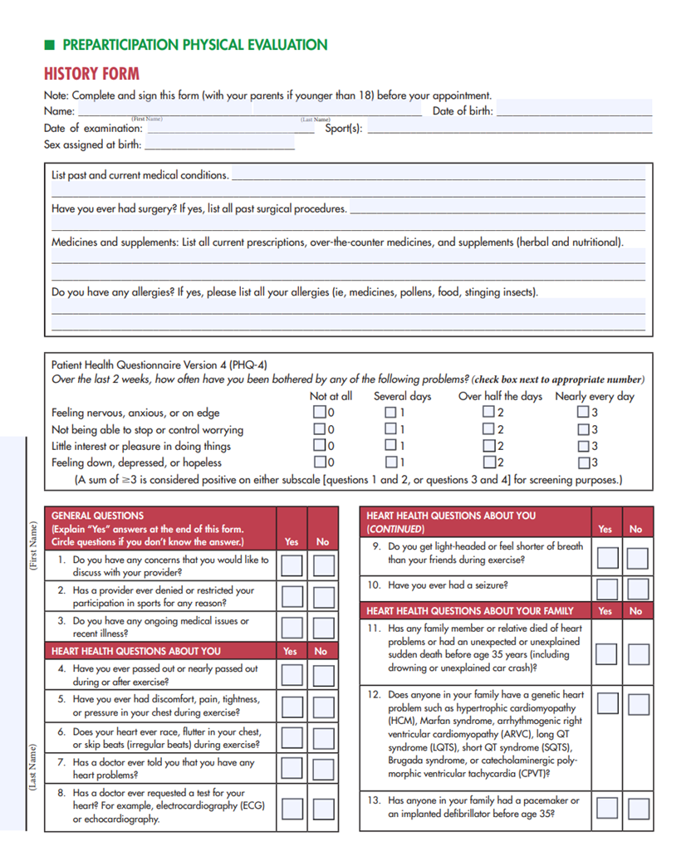
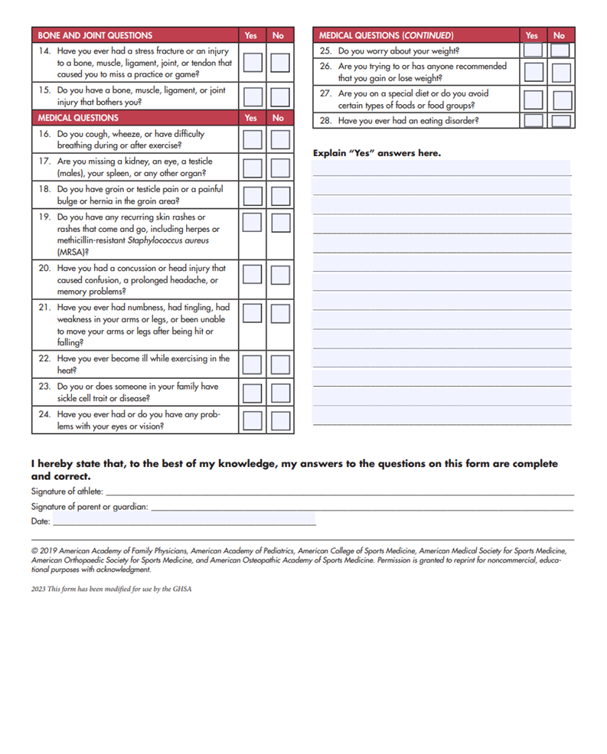

Slide 10
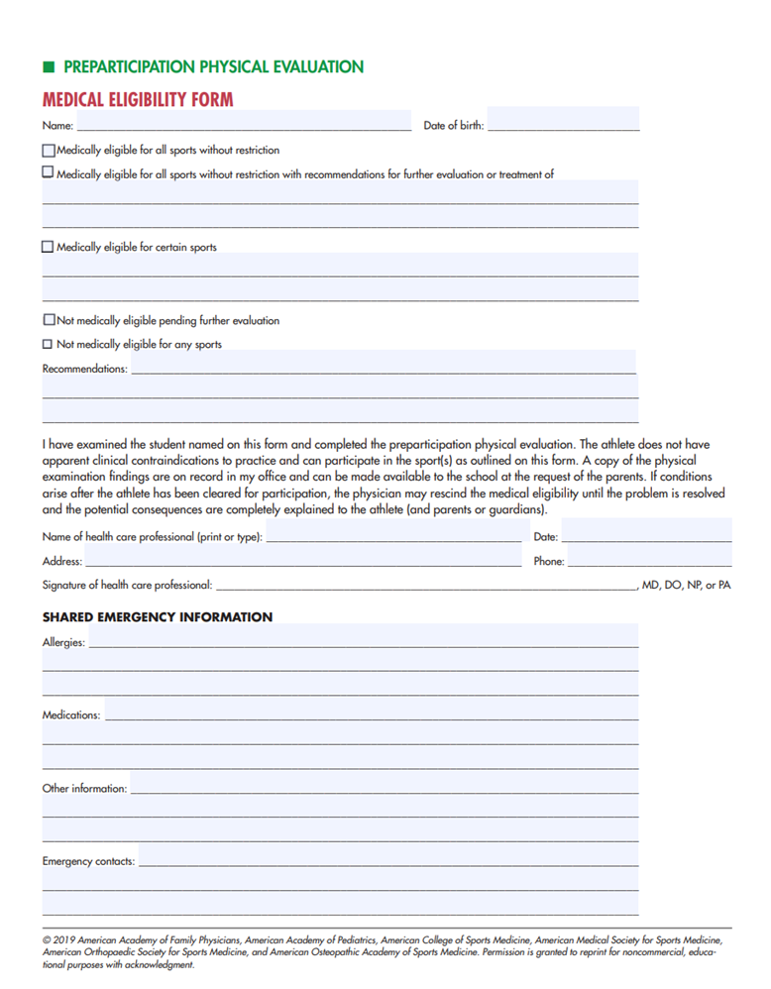
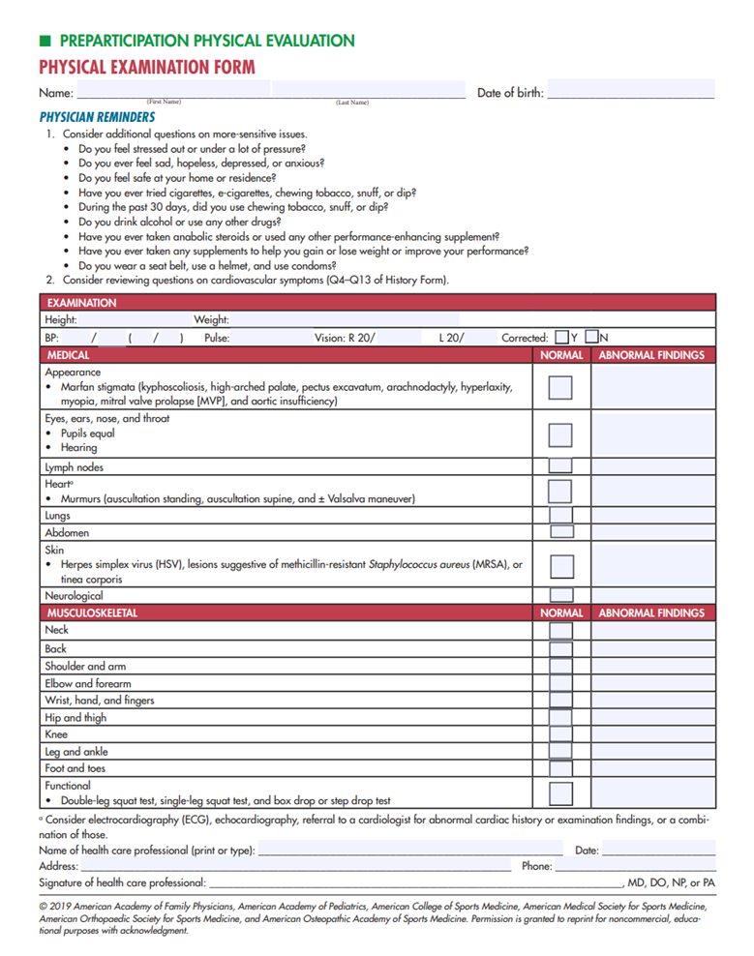

Slide 11
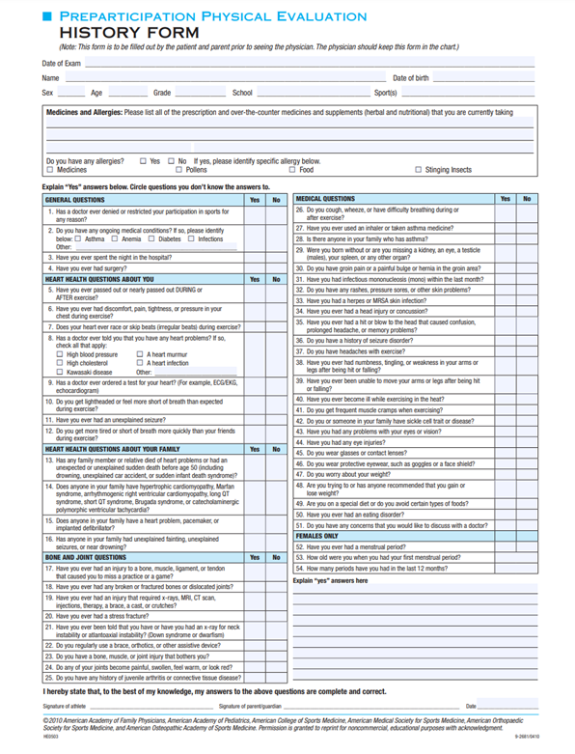
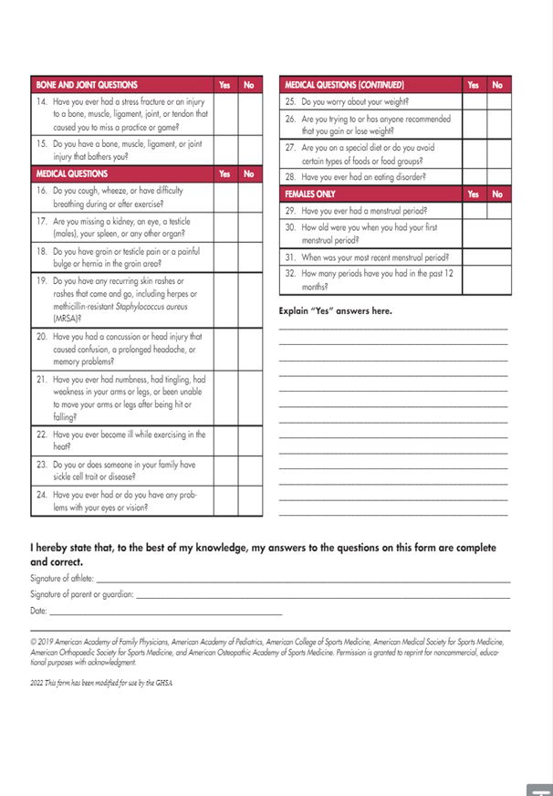
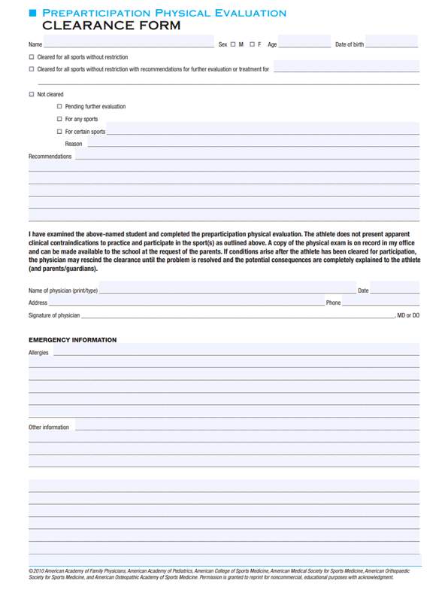
How Do I Know If I Have The Right Form?

Slide 12
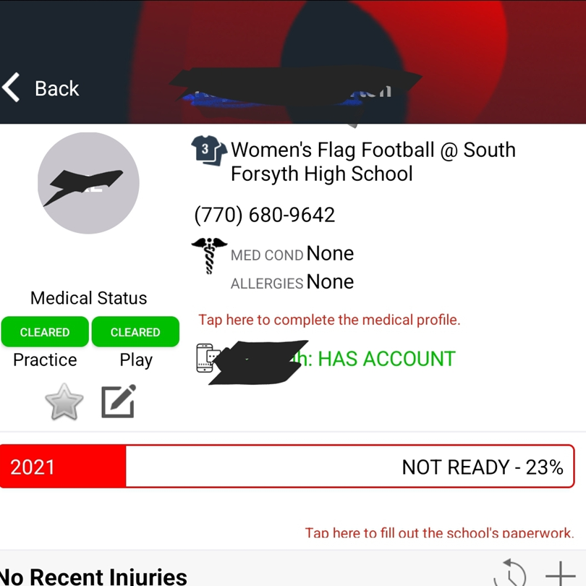
THIS DOES NOT MEAN YOU ARE CLEARED?
  If you are attempting to use the phone app, don’t let this fool you.
  The app works for uploading a form
  The app works on Apple, rarely on Android

Slide 13
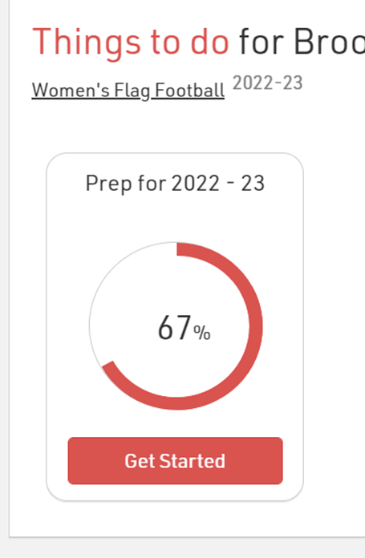
  From your Computer, Click on GET STARTED
  Fill out all forms electronically including Health History Form

Slide 14
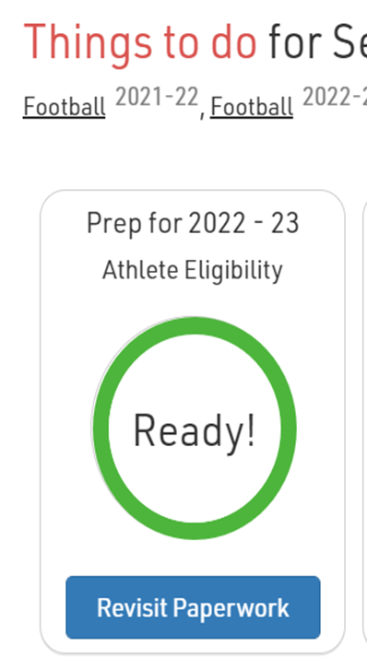
WHEN YOU SEE THE GREEN CIRCLE, THEN YOU ARE COMPLETE AND YOU ARE READY TO PARTICIPATE
Please do this before you text or email a coach or an athletic trainer to check and see if you did everything.

Slide 15
DragonFly
HS Athletes ONLY
REMINDERS:
  Use a computer rather than the phone/ tablet
  create ATHLETE account ONLY
  athlete MUST have insurance
  double check the personal information on the profile - esp. cell numbers and emails
  the physical DATE is the DATE of the ACTUAL physical / on the physical form, NOT the date you are uploading info
Dragon Fly: Sign Up Instructions
GHSA Pre-Participation Physical Form

Slide 16
Tryouts: What to Expect
  Junior War Eagles
  learn the game and the skills of volleyball
  Freshmen team
  improve skills, learn game strategy, develop positions
  jV team
  same as above + prepare for future varsity level play
  Varsity
  develop team that competes for a region title, state play-offs, develop players who want to play at the collegiate level
Once a player is selected for a team, she is expected to attend
ALL practices and matches.

Slide 17
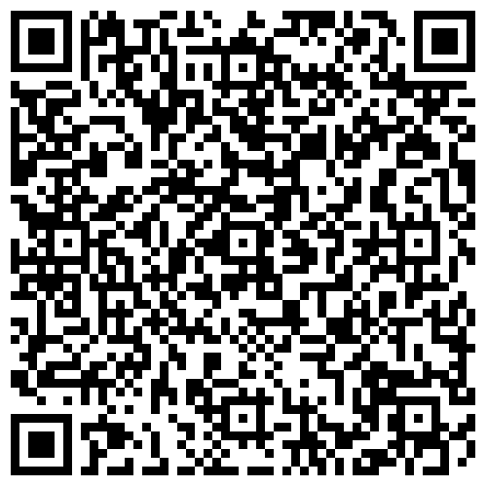
HS Tryout Registration
Use qr code below:

Slide 18
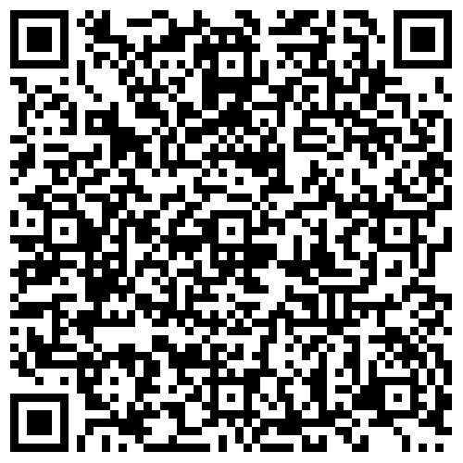
Jr Eagles Tryout Registration
Use qr code below:

Slide 19
Tryout Results
All Teams will be announced on the South Forsyth Volleyball Website by athlete tryout number
the evening of May 11, 2024.
website:
southforsythvb.com

Slide 20
South Forsyth Volleyball
booster board
Amanda Christian
amandabchristian@gmail.com/ 214-733-9665
Brooke Giles
abrookegiles@gmail.com/ 678-315-5648
Rinky Karthik
rinky.karthik@live.com/ 904-887-2251
Nancy Urban
nancyurbancellars@gmail.com/ 770-714-2660

